Slide 1
Discussion Section (Week 3)
CSCI 561 - Foundation for Artificial Intelligence
PROF WEI-MIN SHEN WMSHEN@USC.EDU

Slide 2
Outline
1. Function Optimization
2. Constraint Satisfaction
3. Game Playing

Slide 3
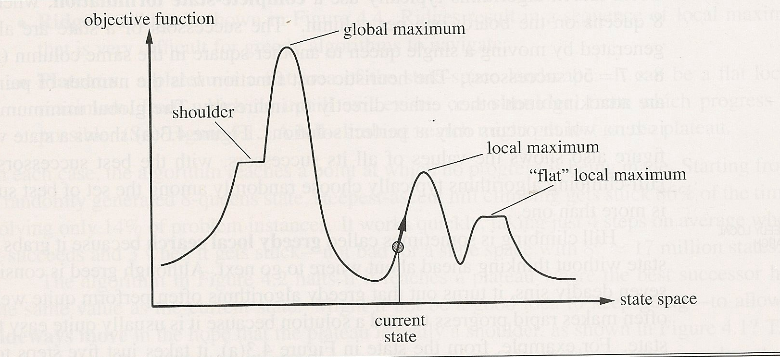
What Is Optimization? So “Simple”?
Given: a hidden objective function F(x)
Find: a x* such that F (x*) is the global extreme:
F (x*) = max{ F(x) } or F(x*) = min{ F(x) }

Slide 4
Why Is It So Important?
All engineering problems are optimizations!
Design: architecture, software, robots, website, …
AI systems: industry, agriculture, military, finance, …
For yourself: Getting good grades ☺
The key challenge is: How to represent them properly
For Search, you can represent your desires as the objective function
Choice 1: x as a state, F(x) as the “rewards” of states
Choice 2: x as a path, F(x) as the “rewards” of paths
Degree of “goodness”: goal related, cost related, etc.

Slide 5
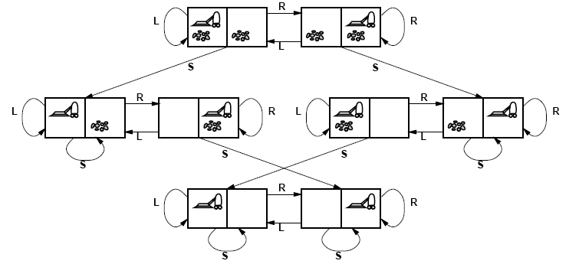
Represent Problems as Optimization
How to represent this problem as an optimization problem?
x: 00, 01, 10, 11
State: LeftRoom_RightRoom, (dirty=0, clean=1)
F(x)=x; “the cleaner the room, the higher F(x)”

Slide 6
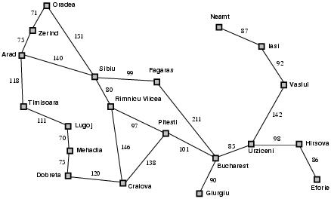
Representing as optimization
Choice 1: x as a city
F(x) is the distance from x to Budapest
Choice 2: x is a sequence of cities starting from Arad
F(x) has a higher value if the path ends at Budapest
What about “leads to Budapest”? What about the “cost”?

Slide 7
Why is optimization so hard?
f(x)
x

Slide 8
Why is it so hard?
Which way to go next?
How much can you see? (local/partial vs global/complete sensors)
How many points can you remember (incremental)?
How small is your step? (not to skip x*)
How to get from one x to another (bound by actions)?
How well can you guess (the next x)?
What do you know about the function (continuous)?
How to check if you are done (avoid local extremes)?
Will the function F(x) change by itself (often does)?
How to design the objective function?
In AI, we call it the Representation Challenge
We still don’t have a general solution for all
We will illustrate all these using the following story

Slide 9


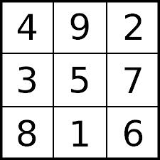
Representation Challenge for AI
Why is “representation” so important?
A great example from Herbert A. Simon
Game: Make a book of 15 from 9 cards
Goal: first does wins (can you always win?)
“The Science of the Artificial” p131
How to find a good representation
is still an open challenge for AI

Slide 10
Some Optimization Methods
Dynamic programming
Hill climbing
Idea: Use local gradient(x) to determine direction, always heads to the better
Pros: simple, local, incremental, no memory
Cons: may be trapped in local extreme
Simulated Annealing
Ideas: long and random jumps when temperature is high
Pros: may avoid local extreme
Cons: expensive, not always find x*,
Genetic algorithms
Sampling techniques (e.g., random walks)
Online (incremental) search
Non-stationary search techniques
Many more “new” methods are being invented as we speak

Slide 11
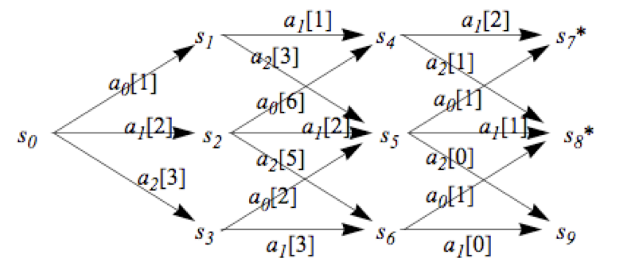
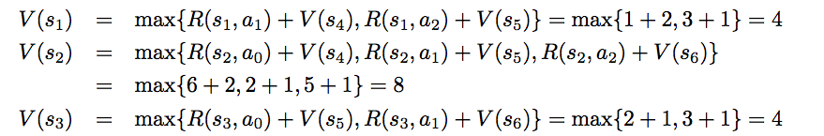
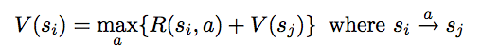
Dynamic Programming for Optimization (see ALFE 6.1.1)
Note: x is a state, but f(x) is about the most rewarding path from x to a goal sate

Slide 12
Iterative Improvement
In many optimization problems, path is irrelevant;
the goal state itself is the solution.
Then, state space = space of “complete” configurations.
Algorithm goal:
- find optimal configuration (e.g., TSP), or,
- find configuration satisfying constraints
(e.g., n-queens)
In such cases, can use iterative improvement algorithms: keep a single “current” state, and try to improve it.

Slide 13
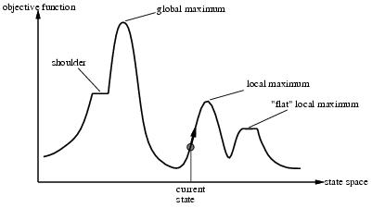
Hill Climbing
Move continuously in the direction of increasing value
Go to best successor of current state, based on evaluation
If more than one best successor, pick randomly among them
Terminate when reach a peak
May only find a local maximum
This form of hill climbing is also referred to as
Steepest-ascent hill climbing
Greedy local search
Continuous analogue is gradient ascent
Notes:
One dimensional space

Slide 14
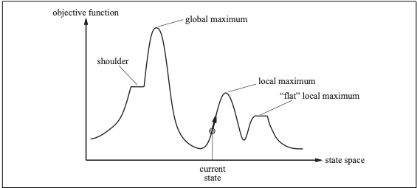
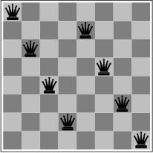
Hill Climbing
What are the advantages and disadvantages of classical hill-climbing?
Can you think of real-world examples where hill-climbing would be particularly good?
What about bad?
Notes:
The success of hill climbing depends very much on the shape of the state-space land- scape: if there are few local maxima and plateaux, random-restart hill climbing will find a good solution very quickly. On the other hand, many real problems have a landscape that looks more like a widely scattered family of balding porcupines on a flat floor, with miniature porcupines living on the tip of each porcupine needle, ad infinitum. NP-hard problems typi- cally have an exponential number of local maxima to get stuck on. Despite this, a reasonably good local maximum can often be found after a small number of restarts.

Slide 15
Key Questions
How big is your step?
You “walk”, but do you “jump”? When? How far?
When do you stop?
Is you technique deterministic and complete?

Slide 16
Simulated Annealing
Escape local maxima by allowing “jump” moves
When to jump?
If you always jump too much, then you never settle down
Gradually decrease the likelihood to jump over time
Use temperature to determine the likelihood to jump
Reduce temperature T slowly over the time
How far to jump?
Too close? Too far? Random?
If T decreases slowly “enough,” then you can find the optimal extreme
How slow? Infinitely slow
Theoretically OK, but infeasible in practice

Slide 17
Simulated Annealing
The AIMA book says that simulated annealing is complete (page 125).
In real-world applications will that be true?
Why or why not?

Slide 18
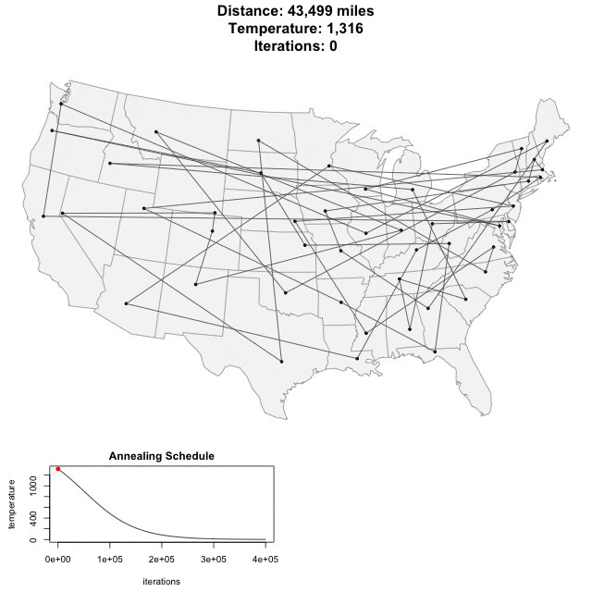
http://toddwschneider.com/posts/traveling-salesman-with-simulated-annealing-r-and-shiny/

Slide 19

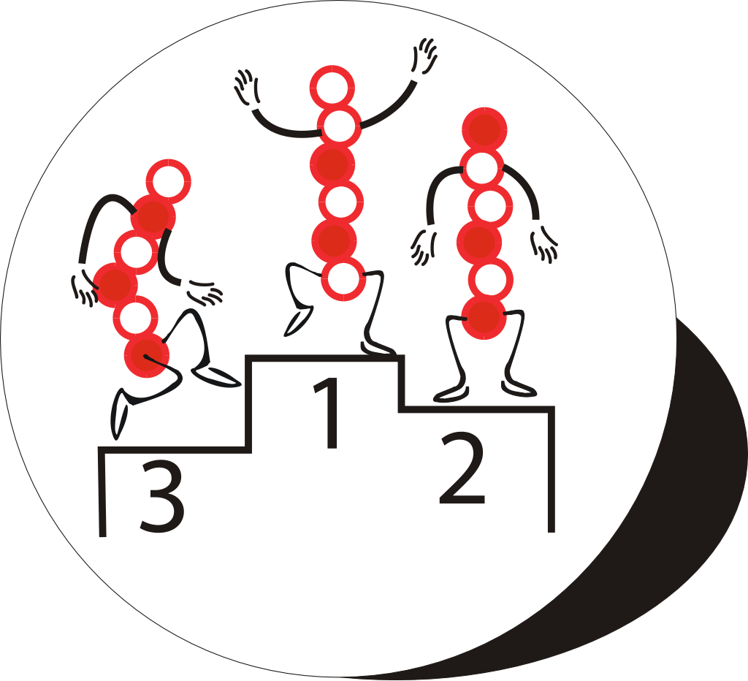
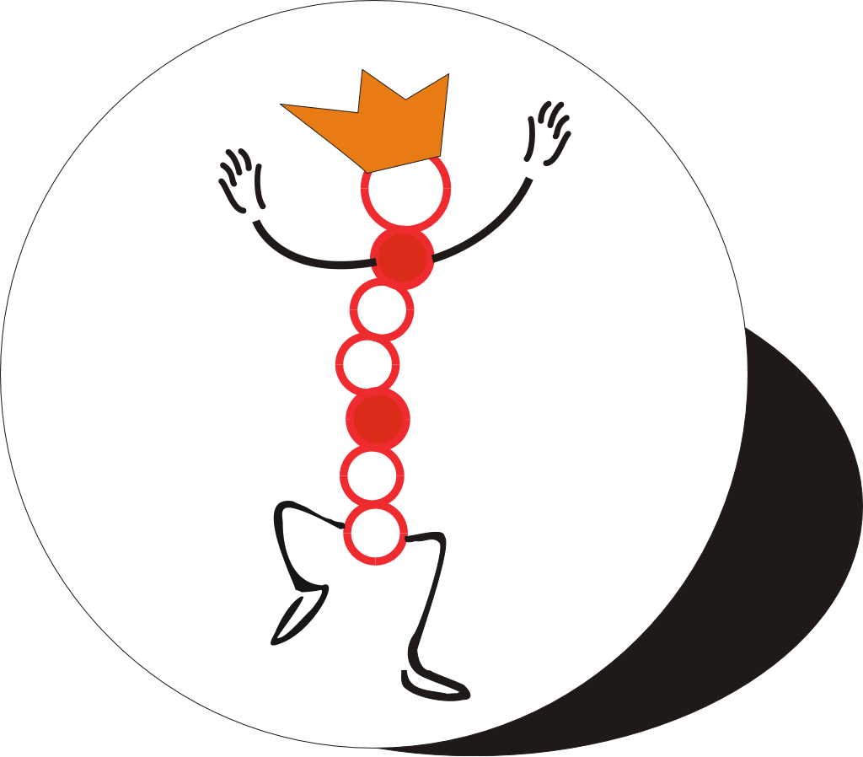
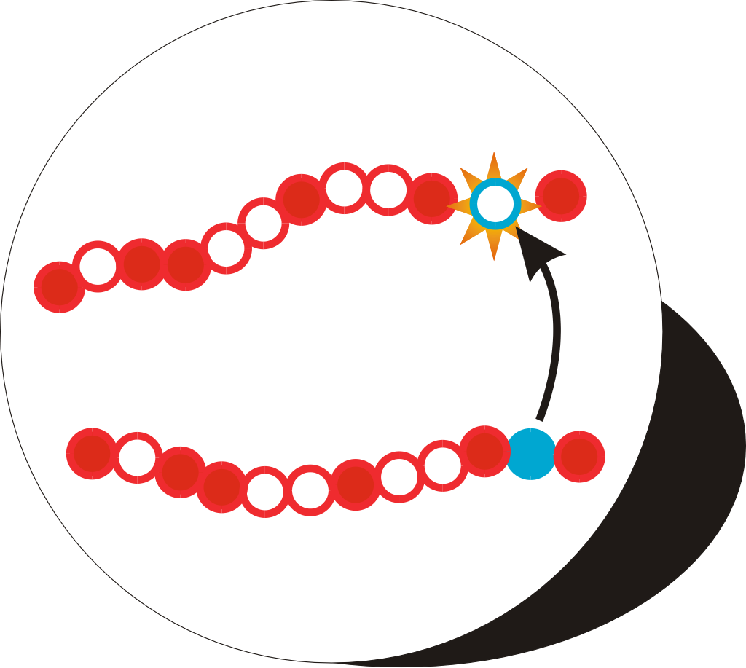
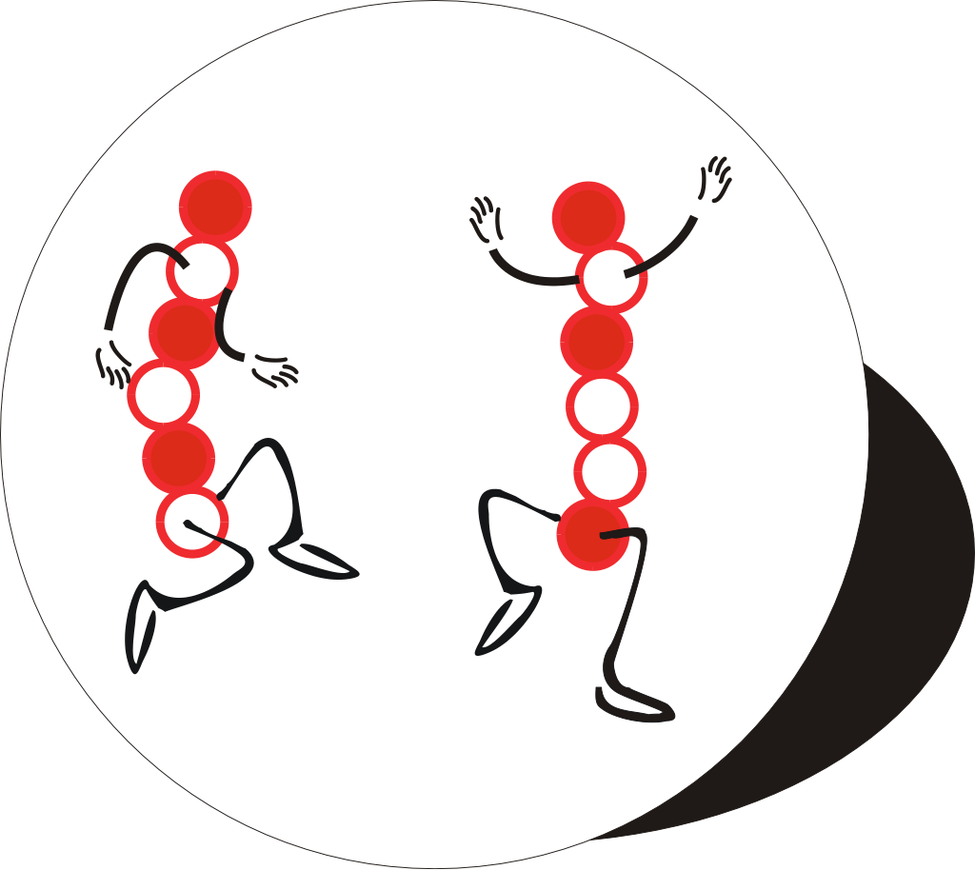
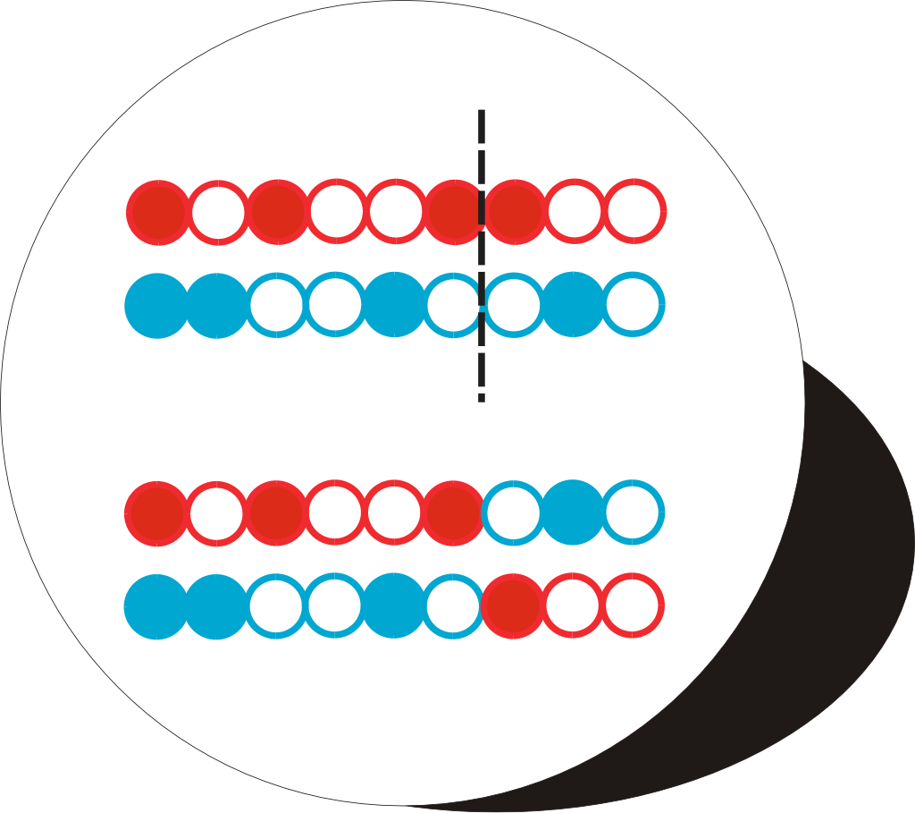
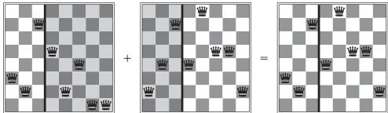
The Genetic Algorithm Cycle
New Population
Fitness
Selection
Mutation
Crossover
Notes:
Summary of the previous steps to the model.
Populations are continuously produced, going round the outer loop of this diagram, until the desired amount of optimisation has been achieved.

Slide 20
CSP Example: Map Coloring
NT
NT
Q
Q
WA
WA
SA
SA
NSW
NSW
V
V
T
T
7 variables {WA,NT,SA,Q,NSW,V,T}
Each variable has the same domain {red, green, blue}
No two adjacent variables have the same value:
WA≠NT, WA≠SA, NT≠SA, NT≠Q, SA≠Q, SA≠NSW, SA≠V,Q≠NSW, NSW≠V

Slide 21
Backtracking Search: Map Coloring
{}
WA=red
WA=green
WA=blue
WA=red
NT=green
WA=red
NT=blue
NT
Q
WA
WA=red
NT=green
Q=red
WA=red
NT=green
Q=blue
SA
NSW
V
T

Slide 22
Constraint Propagation
Which variable X should be assigned a value next?
In which order should its values be tried?
Variable Selection:
“Most constrained variable” or “Minimum Remaining Values”
Degree: variable involved in most constraints on others (tiebreaker)
Value Selection:
Least constraining value
NT
NT
Q
WA
WA
SA
NSW
V
{blue}
T

Slide 23
When to use CSP Techniques?
When the problem can be expressed by a set of variables with constraints on their values
When constraints are relatively simple (e.g., binary)
When constraints propagate well (AC3 eliminates many values)
Local Search: when the solutions are “densely” distributed in the space of possible assignments

Slide 24
Game Playing -- Adversarial Search
MAX
x
o
x
o
x
o
win
lose
x
o
x
x
o
x
x
o
x
MIN
draw
x
o
x
o
x
o
x
o
x
o
x
o
x
o
x
x
o
x
x
o
x
x
o
x
x
o
x
x
o
x
MAX
x
o
x
x
o
x
o
o
x
o
x
o
o
x
o
x
o
o
o
o
x
o
x
o
o
x
o
o
x
o
x
o
x
x
o
x
x
o
x
x
o
x
x
o
x
o
o
x
o
o
x
x
o
x
o
x
o
x
x
o
x
x
o
o
x
o

Slide 25
Minimax Algorithm
MAX
6
α: at least max can get this much
β: at most min will give this much
Update [α, β], cut if v is out range
MIN
6
-8
-9
15 10 6 12 -8 7 5 25 -9
Notes:
When the minimax algorithm visits the rightmost node on the 2nd level, it knows that MAX can already get at least 6 from somewhere else, so when MIN offers a 5 there, the algorithm does not need to care about the rest of the nodes, 25 and -9, so it cuts them.

Slide 26
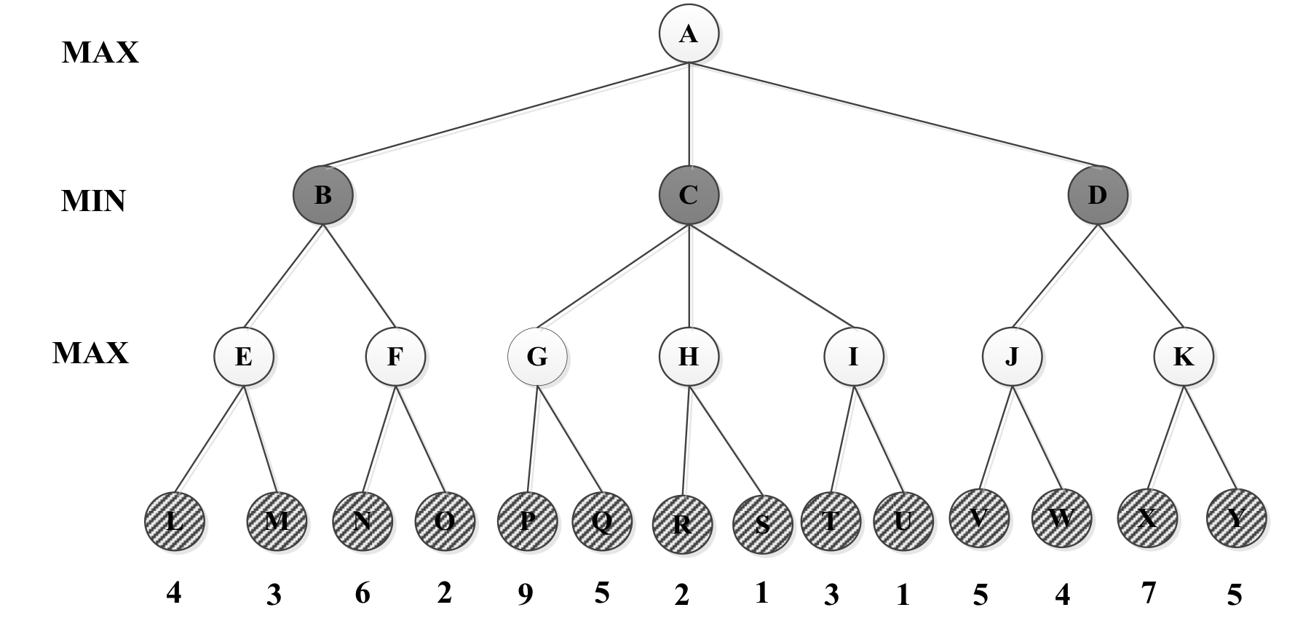
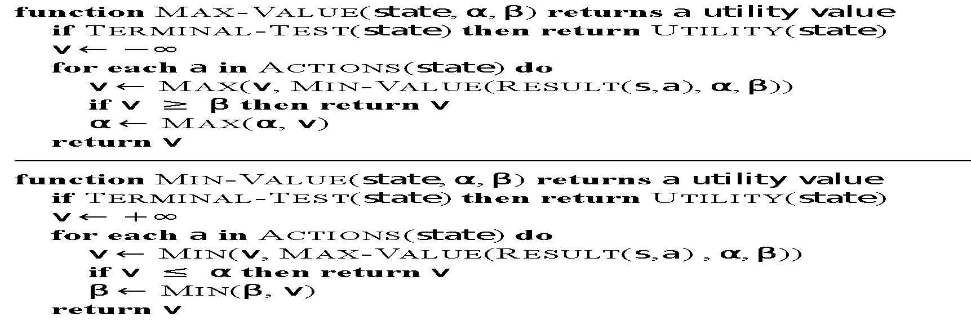
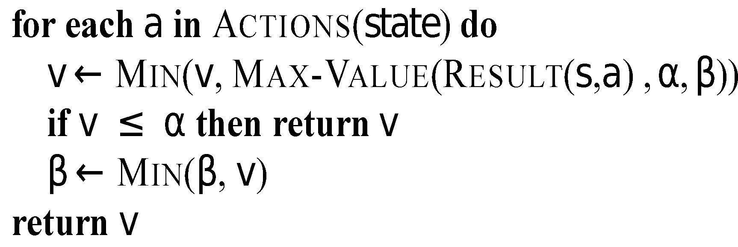
α: at least max can get this much
β: at most min will give this much
Keep update [α,β] if v is in range, or else cut the branches
=5
β = +∞
v = 5
=-∞
β = +∞
v = -∞
=4
β = +∞
v = 4
= 4
β = +∞
v = ∞
= 4
β = 9
v = 9
= 4
β = 9
v = 2
= 4
β = +∞
v = ∞
=-∞
β = +∞
v = ∞
= 4
β = 5
v = 5
=-∞
β = 4
v = 4
=4
β = ∞
v = -∞
=9
β = ∞
v = 9
=4
β = 5
v = -∞
=4
β = +∞
v = 4
=4
β = 5
v = 7
=-∞
β = +∞
v = -∞
=4
β = 9
v = -∞
=4
β = ∞
v = -∞
=-∞
β = 4
v = -∞
=4
β = 9
v = 2
=5
β = ∞
v = 5
=-∞
β = 4
v = 6
Max Node
Min Node

Slide 27
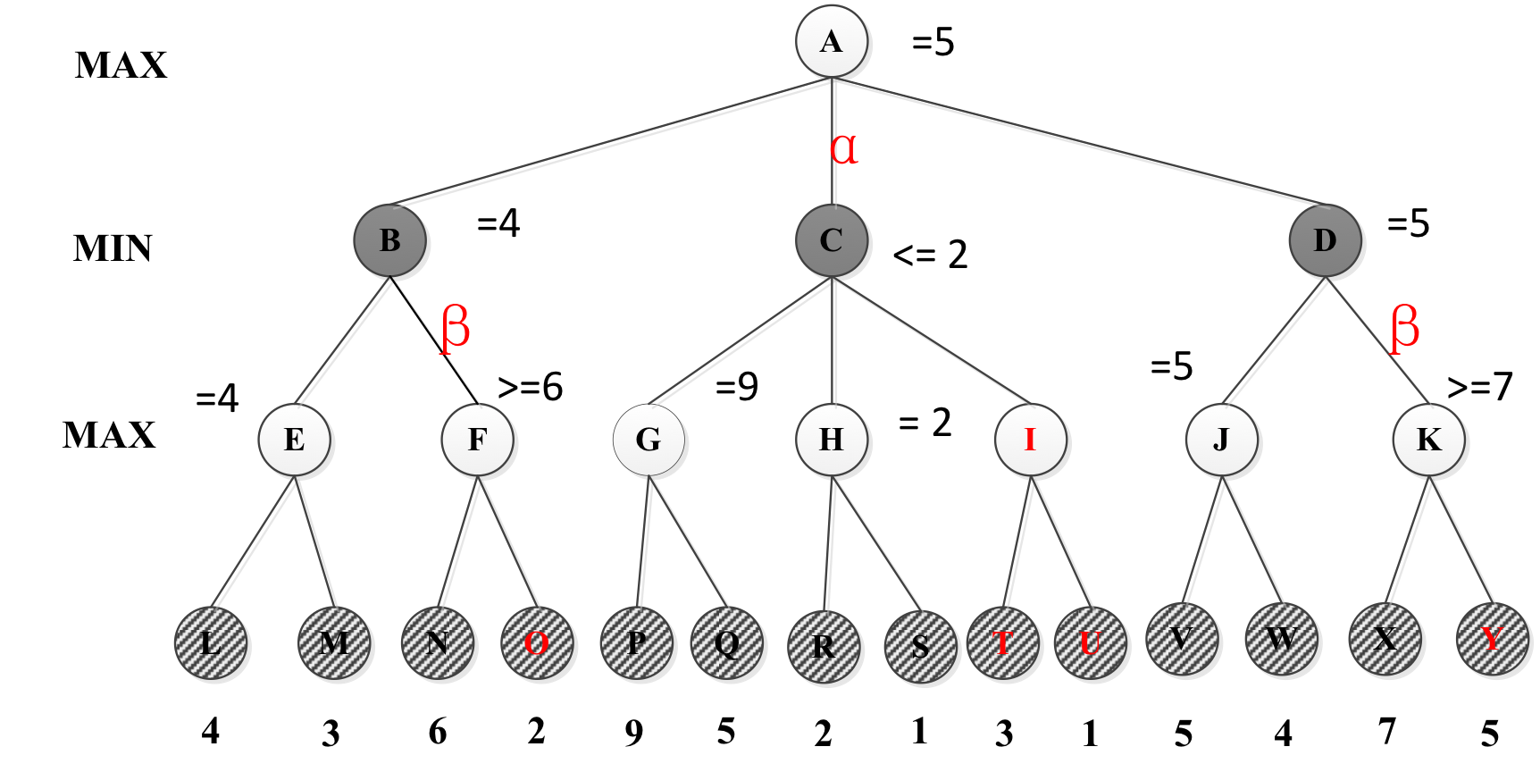

Slide 28
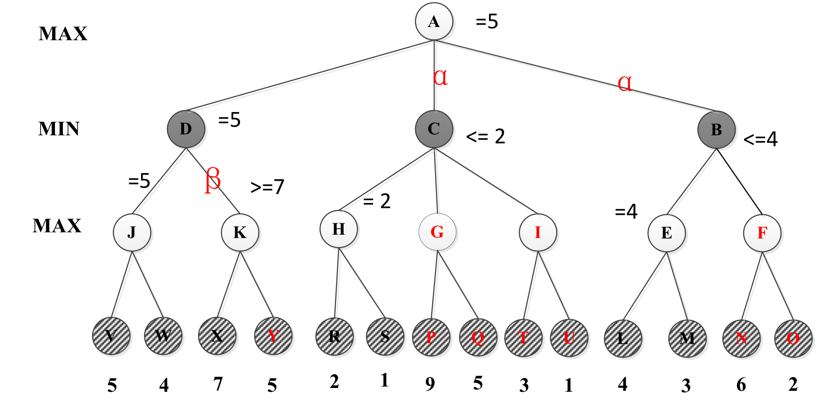

Slide 29
What you should know
What are the characteristics of local search? Is it complete? Optimal? Time and Space complexity?
What problem domains are well-suited to each type of search technique? Ill-suited? Why?
Know how to compare their performance in general and in a specific domain or problem.
What is the difference between uninformed and informed search? Which ones are optimal?
What are the advantages and disadvantages of depth-first search?
Why does a search heuristic need to be “admissible”?
What are the characteristics of Adversarial Search?
Why is meta-reasoning important in adversarial search?
Notes:
http://cse.unl.edu/~choueiry/S03-476-876/searchapplet/
https://courses.cs.washington.edu/courses/cse473/06sp/MazeRunnerDemo/search/applet.html
http://www.briangrinstead.com/files/astar/
http://www.cs.rmit.edu.au/AI-Search/Product/

Slide 30
Want more?
Check out these demos:
http://toddwschneider.com/posts/traveling-salesman-with-simulated-annealing-r-and-shiny/
http://codecapsule.com/2010/04/06/simulated-annealing-traveling-salesman/
http://www.biostat.jhsph.edu/~iruczins/teaching/misc/annealing/animation.html
http://math.hws.edu/eck/jsdemo/jsGeneticAlgorithm.html
http://rednuht.org/genetic_walkers/
http://rednuht.org/genetic_cars_2/
Alpha-beta search demo:
https://www.yosenspace.com/posts/computer-science-game-trees.html
A* and heuristics:
http://www.briangrinstead.com/files/astar/
Practice Exercises: Chapter 4: # 4.1, Chapter 6: # 6.1, 6.5

